Slide 1
Automatic water gardening system

Slide 2
INTRODUCTION:
It Is The Artificial Application Of Water To The Land Or Soil.
It Is Used To Assist In The Growing Of Agricultural Crops, Maintenance Of Landscapes And Re-vegetation Of Disturbed Soils In Dry Areas And During Periods Of Inadequate Rainfall.

Slide 3
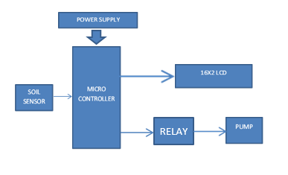






Block Diagram of Automatic water gardening System:
RELAY

Slide 4
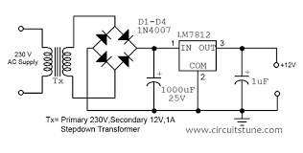
POWER SUPPLY:

Slide 5
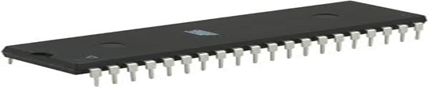
MICROCONTROLLER:
The microcontroller receives the signals from the sensors, and this signal is operated under the control of software which is stored in ROM.
Microcontroller AT89S52 continuously monitors the Infrared Receivers.

Slide 6
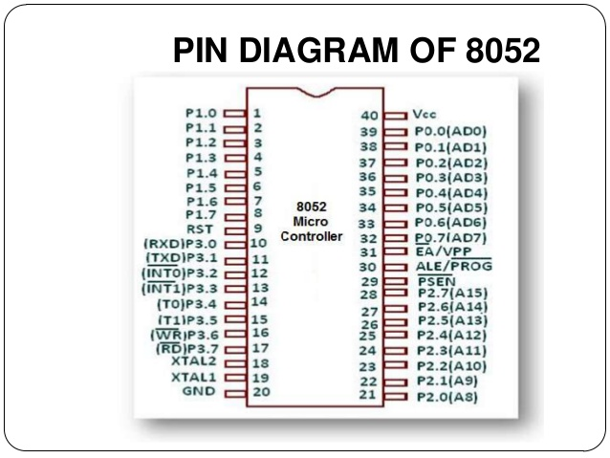

Slide 7
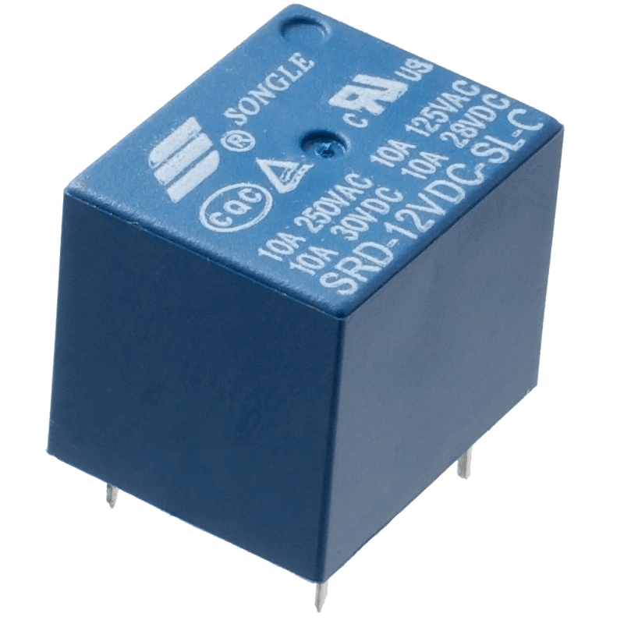
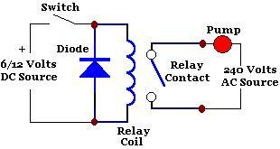
RELAY DRIVER CIRCUIT:
Potential to drive the various controlled devices.
transistor and the relays are used.
Output signal from AT89S52 is given to the base of the transistor, which we are further energizing the particular relay.
Because of this appropriate device is selected and it do its allotted function.

Slide 8
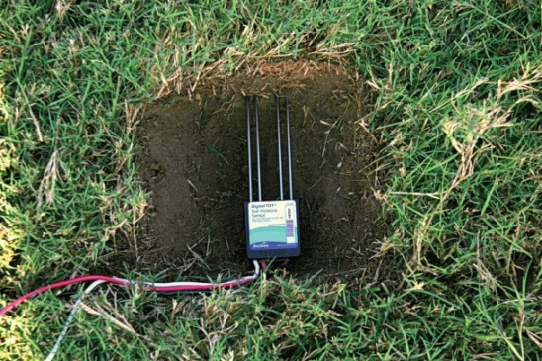
Soil moisture sensor:
Soil moisture sensors measure the water content in the soil.
Soil moisture sensors measure some other property, such as electrical resistance, dielectric constant, or interaction with neutrons, as a proxy for moisture content.
Reflected microwave radiation is affected by the soil moisture and is used for remote sensing in hydrology and agriculture.

Slide 9
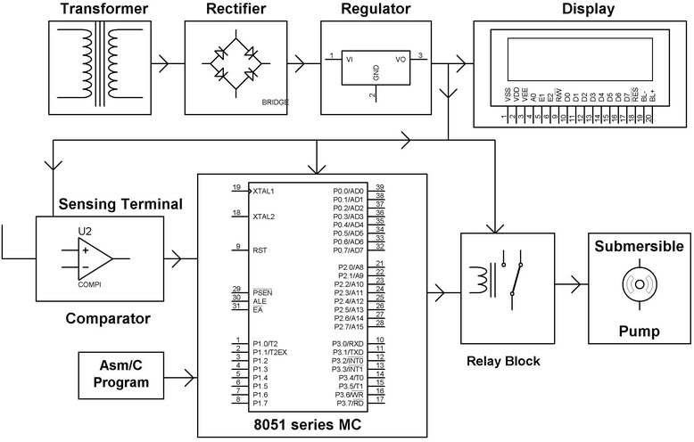
CIRCUIT OF GARDENING SYSTEM:

Slide 10
Working of Automatic water gardening System:
The power supply consists of a step-down transformer, which steps down the voltage to 12V AC.
In microcontroller data is processed , this process is done by sensing soil by soil sensor and the status of the soil is send to micro controller.
When the sensor circuit senses the condition of the soil, it compares it with the reference voltage 5v.
Thus according to status the motor will be ON/OFF and displayed on LCD.

Slide 11
Merits:
Highly sensitive, Low cost and reliable circuit.
Works according to the soil condition.
Complete elimination of manpower.
Can handle heavy loads.
System can be switched into manual mode whenever required.

Slide 12
Demerits:
This is applicable for only large farms.
Have limited life after installation due to the detoriation of the plastic component in a hot, arid climate when exposed to ultraviolet light to ultraviolet light.

Slide 13
Applications:
Useful in field for crop.
Useful in Gardens, Parks.
This water System is very efficient for Paddy, Rice Fields.

Slide 14
Conclusion:
In present days, especially farmers are facing major problems in watering their agriculture fields, it’s because they have no proper idea of when the power is available so that they can pump water.
Even after then they need to wait until the field is properly watered, which makes them stop doing other activities.
Here is an idea that helps not only farmers even for watering the gardens also, which senses the soil moisture and switches the pump automatically when the power is ON.
Automatic water gardening System is very useful.

Slide 15
Future scope:
The working of the project is dependent on the output of humidity sensors. Whenever there is a need for excess water in the desired field (RICE crops), then it will not be possible by using sensor technology.

Slide 16
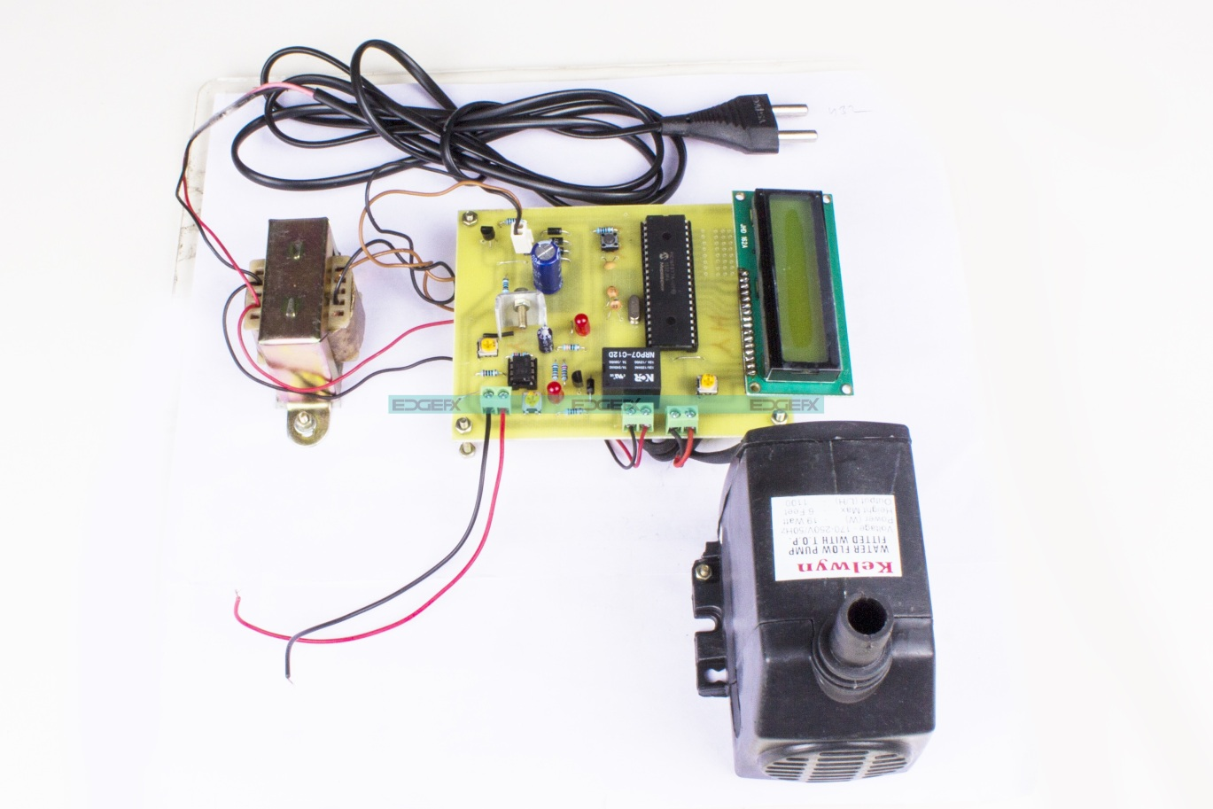
AUTOMATIC WATER GARDENING SYSTEM

Slide 17
Thank You

